Slide 1
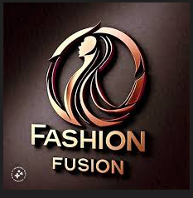
Fashion Fusion : Where Style Meets Innovation.
Md. Maydul Islam
Batch: 041
Department of Public Administration
08-12-2024

Slide 2
Overview:
A leading brand that merges traditional craftsmanship with contemporary design.
Founded in 2020
Mission: To create timeless pieces that celebrate individuality.
Vision: To become a global icon of modern fashion fusion.

Slide 3

FASHION FUSION
"FASHION FUSION"
is an ultimate shopping destination where you can shop the widest selection of casual or luxurious trendy, unique or traditional cloths and accessories delivered to you directly anywhere in Bangladesh

Slide 4

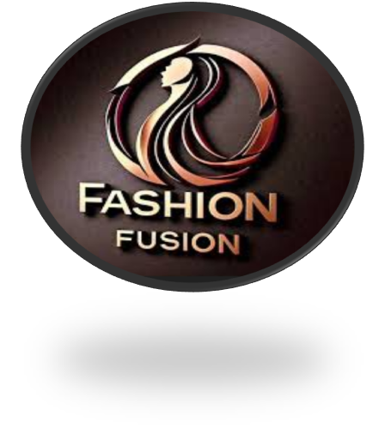
Fashion Industry Ramp Show Video:

Slide 5
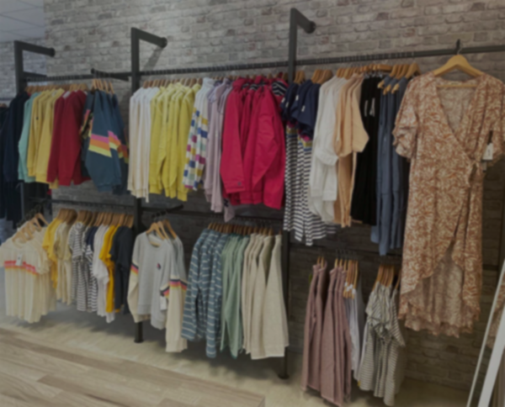
E-Business Structure of Fashion Fusion Business idea
Intermediaries
Agent
Contract
Courier service
Direct hand
over
Suppliers
Organization
Customer
Order Place
Phone
Web-site
Direct visit
Destination Site
Web-site
Media site
Showroom

Slide 6
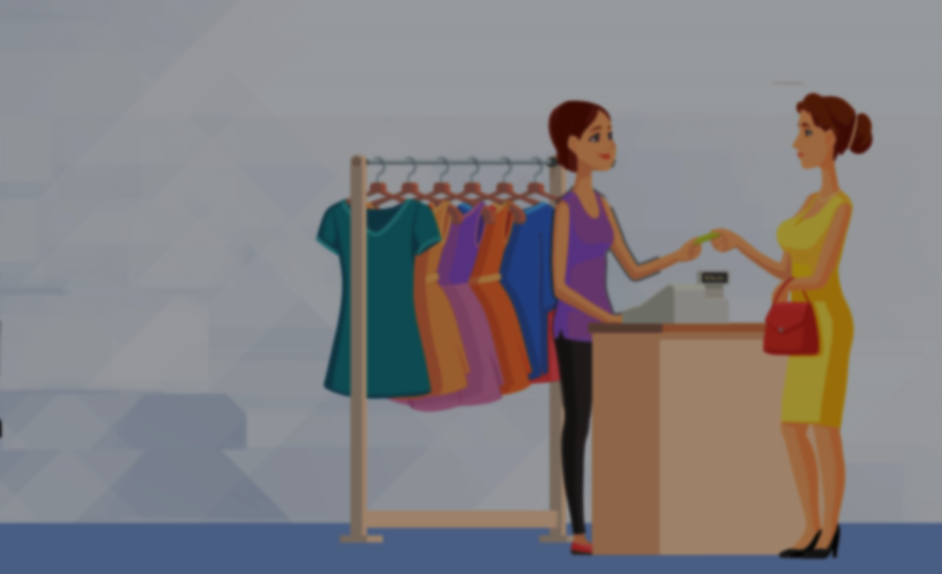
Importance Of Online Intermediaries
1
2
3
Competitor
Intermediary
Organization
Organization
Destination Site
Media-Site
Customer
Rich-Media

Slide 7
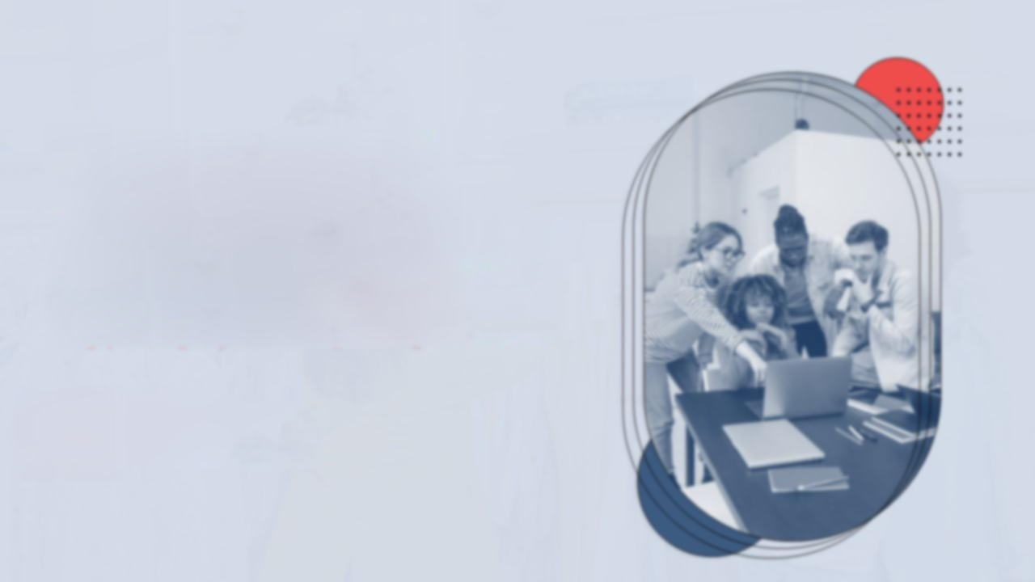
Persona
“Eahan” is a modern, urban man who values comfort, style, and versatility. He’s always on the go, whether it’s for work, travel, or leisure.
Needs:
Functional yet fashionable clothing that transitions seamlessly from day to night.
Pain Points:
Limited time for shopping, overwhelmed by too many choices.
Demographics:
Age: 32
Gender: Male
Occupation: Government
Employee
Location: Barishal
Motivations:
Expressing his individuality, staying updated with trends, and investing in quality pieces.

Slide 8

Persona
“Sally” is a fashion-forward young woman. She’s always looking for unique, eye-catching pieces to add to her wardrobe.
Needs:
High-quality, trendy clothing that reflects her personal style
Pain Points:
Limited time for shopping, overwhelmed by too many options
Description:
Age: 28
Gender: Female
Occupation: Employee
Of MNC
Location: Dhaka
Motivations:
Expressing herself through fashion, feeling confident

Slide 9
Conclusion
Fashion Fusion is poised to revolutionize the fashion industry by offering innovative, sustainable, and personalized solutions. With a strong focus on quality, creativity, and customer satisfaction, we are confident in our ability to establish a lasting legacy in the world of fashion

